Slide 1




A simulation model for determining intermediate care capacity requirements along the complex discharge pathway
Zehra Önen Dumlu¹ Alison Harper² Paul Forte³ Richard Wood³ Christos Vasilakis¹ Martin Pitt²
¹ School of Management, University of Bath
² Exeter Medical School, University of Exeter
³ NHS Bristol, North Somerset and South Gloucestershire CCG
NHS-R conference 2022, Birmingham, UK

Slide 2
Outline
Background
The problem and research opportunity
The IPACS project vision
The simulation model
Application
Next steps

Slide 3




Transfers of care between acute & social care
Elective/Non-elective patient admissions
Delayed Transfer of Care (DTOC)
occur when a patient is deemed ready to depart, but is unable due to non-clinical reasons
Acute care (hospital)
Adult
Community & Social care
Discharge (complex care needs)
NHS budgets
Local government and/or personal savings
Delays in transfers mean fewer hospital beds available, possibly leading to cancelled surgeries, ED overcrowding, ambulances unable to unload patients etc.

Slide 4
NHS England statistics up to Feb 2020
Source: Delayed Transfers of Care Statistics for England 2019/20, NHS England

Slide 5
Improving Patient flow between Acute, Community and Social care (IPACS) project
Strategic
Support decisions on capacity allocation along complex discharge pathways in terms of total costs, patient experience, and patient outcomes
Operational
To provide easy-to-use, open-source, software tools for analysts to support process and capacity decision making
Cultural
For analysts: improve awareness and familiarity of advanced analytics solutions
For leaders: highlight the value of (more) sophisticated modelling approaches and demonstrate the importance of system-wide working

Slide 6
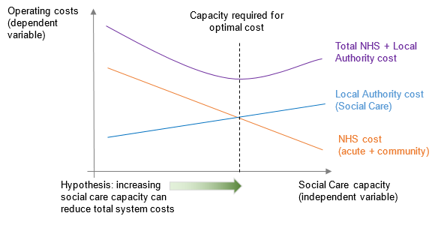
Vision of IPACS project
Ultimately, we want to investigate through empirically informed modelling the following hypothesis:

Slide 7





Non-elective patient admissions
Patients without complex care needs
Acute stay in hospital
Discharge
Intermediate care-up to 6 weeks
X%
Daily visits at usual place of residence
‘Visits’ model
Patients with complex care needs (P% of all discharges)
P1
Delayed Transfer of Care (DToC) at acute hospital
Y%
Bedded care at intermediate facility
No
P2
Available capacity in appropriate pathway?
Yes
‘Bedded’ model
Bedded care at intermediate facility (advanced assessment)
Z%
P3

Slide 8
Model variants
Bedded care
Care is provided in community or care home beds
Length of Stay (LoS) is variable
Each admitted patient consumes one service channel (bed) from admission to discharge
There are a fixed number of service channels (bed capacity)
Visits-based care
Care is provided at the patient’s own home through daily visits
‘LoS’ is variable
Each patient ‘consumes’ a different (reducing) number of daily home visits over their LoS
Capacity (max daily home visits) cannot be exceeded by demanded home visits for patients ‘admitted’ by the service
Our model is adapted for both of the above

Slide 9
Deterministic vs Stochastic methods
For patient flow pathway modelling, health services (still) typically rely on simple spreadsheet ‘tools’ using average arrival rates and LoS
We know that planning by averages can lead to substantial under-estimation of required capacity
Stochastic methods can provide much more reliable results by capturing variability in the input parameters of the model
We are developing a purpose-built, easy-to-use, open-source simulation tool coded in R

Slide 10
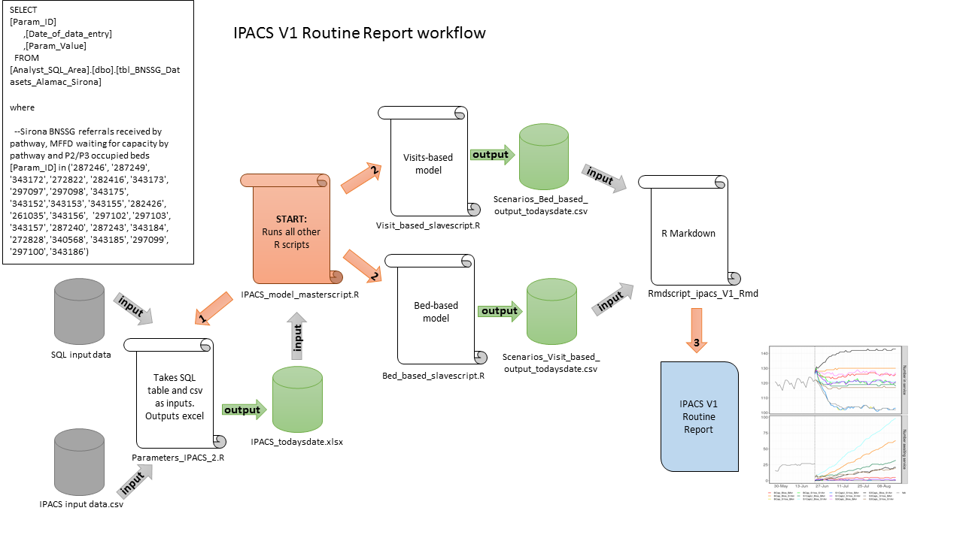
IPACS Routine Report workflow

Slide 11

Input Parameters
Time horizon (e.g., 6 months, 1 year etc.)
Initial occupancy per locality in each pathway
Initial queue in the acute per locality in each pathway
medically fit for discharge, no criteria to reside
Capacity per locality in each pathway
Daily demand rate - Poisson arrivals
Average of daily arrivals (i.e. arrival rate of Monday = average of past Monday arrivals etc.)
Fitted Normal distribution for visits-based duration of care (P1)
Number of visits per patient per day reduces over the duration of care
Fitted Lognormal distributions for bedded care LoS (P2 and P3)
Output Report
Routine report in Microsoft Word generated via Rmarkdown
Information on inputs (description and plots)
Number of locality x Number of pathways sets of plots, each displaying all scenario combinations for each of:
Number in service - the number of patients estimated to be utilising the service given service capacity;
Number awaiting service - the number of patients estimated to be delayed in the acute sector awaiting D2A;
Mean days delayed - the mean number of days delayed in the acute sector.
Costs - Total system cost = Acute delay cost + community service cost
IPACS Simulation tool

Slide 12
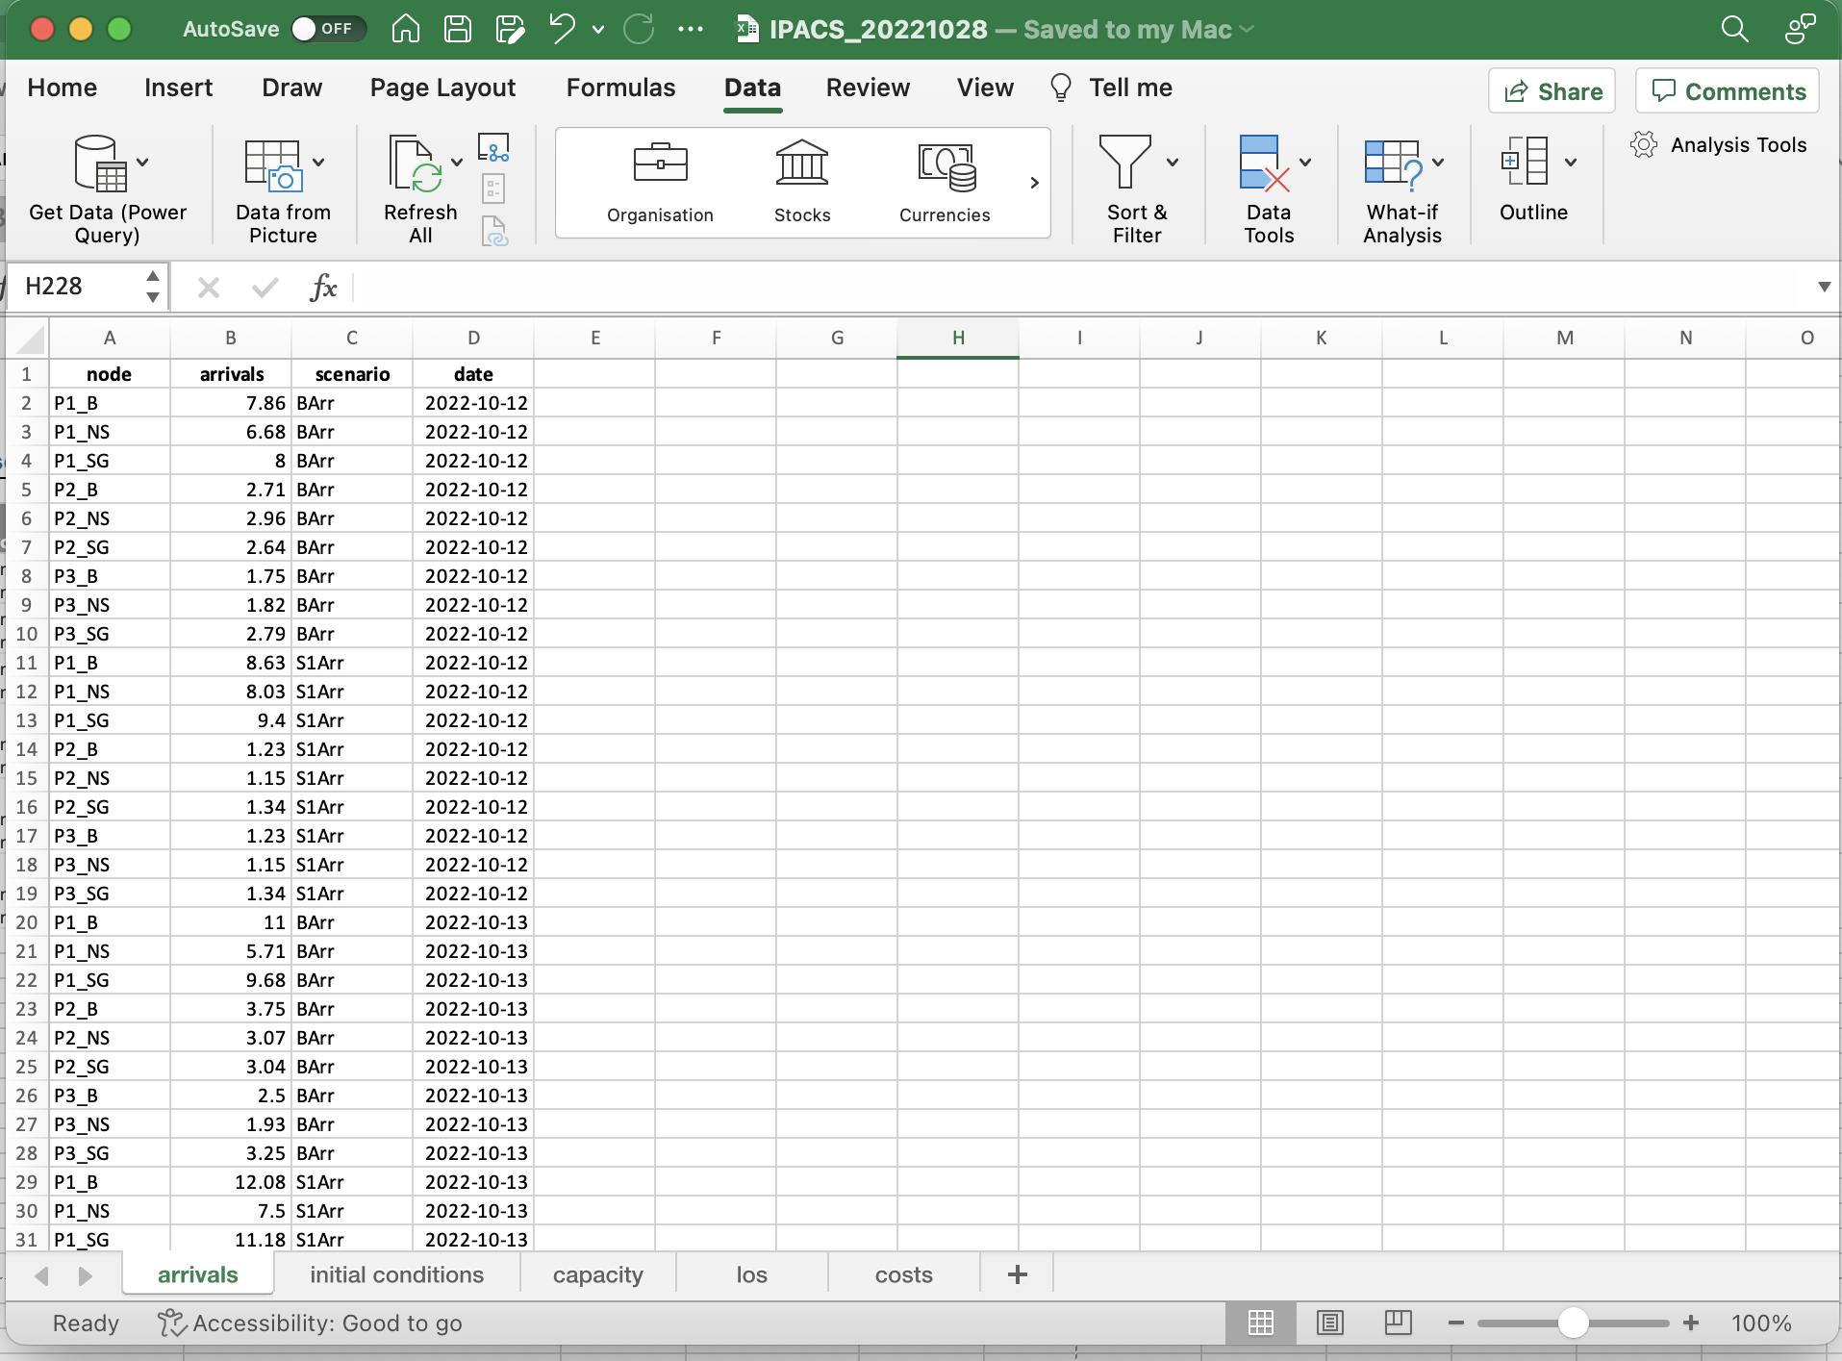
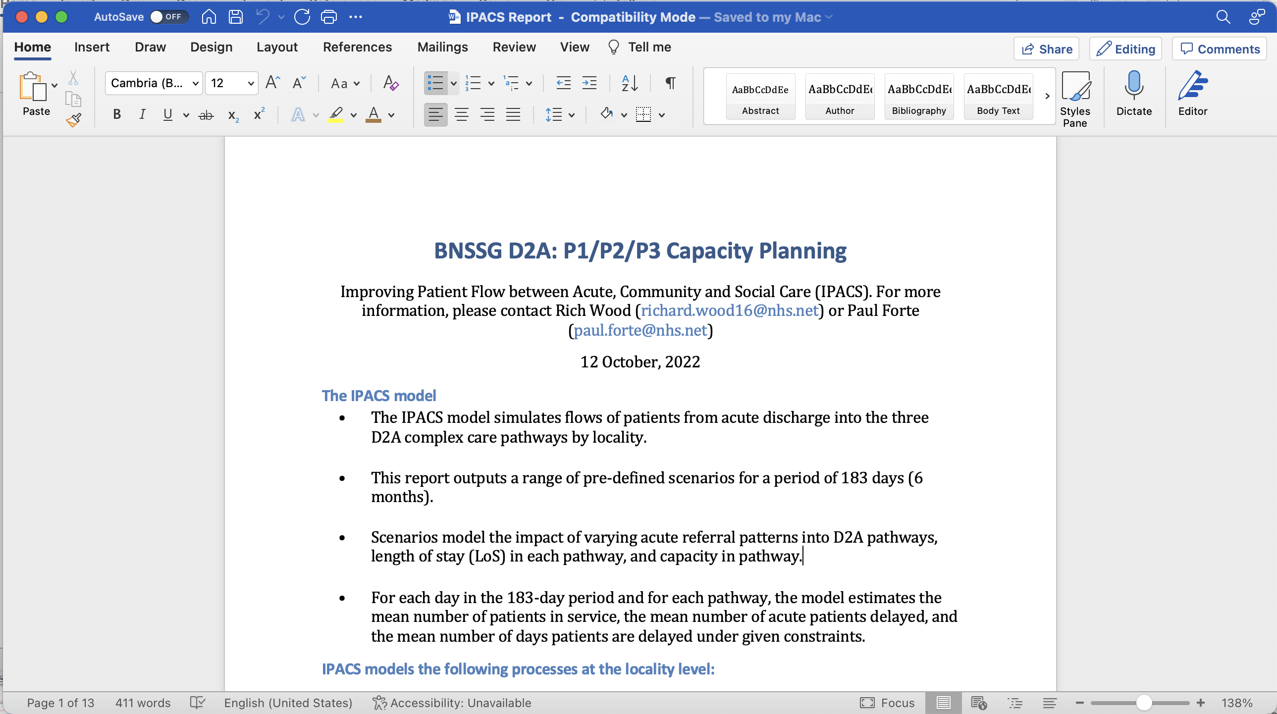
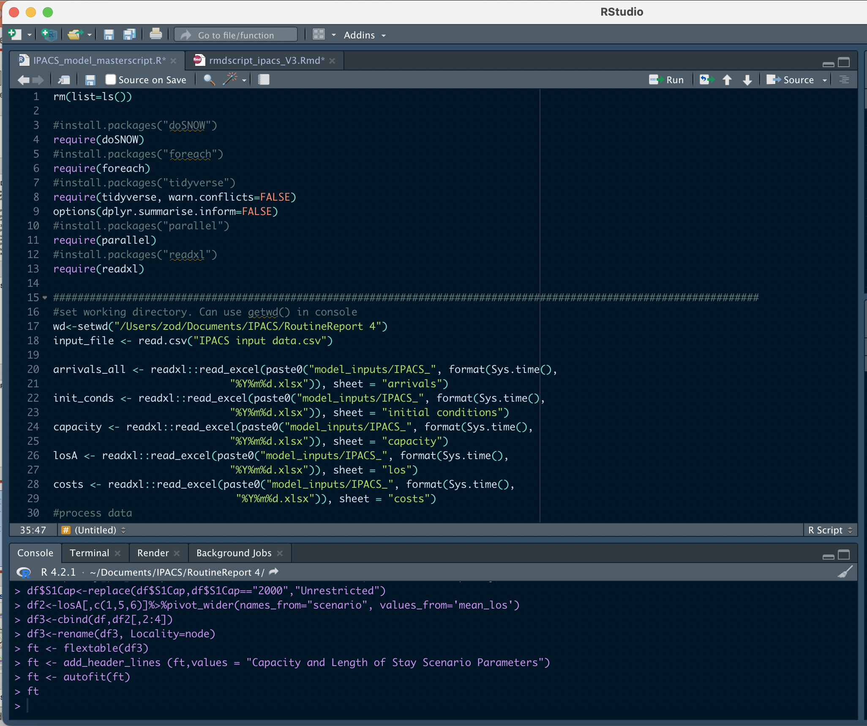
Input Parameters
Output Report
IPACS Simulation tool

Slide 13

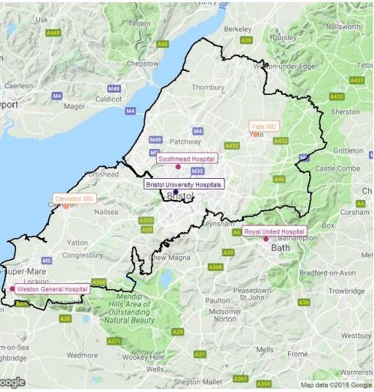
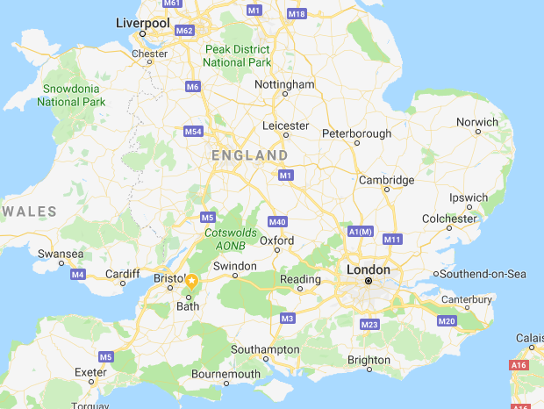
Application
ICBs decide what services are needed for local populations; fund providers; ensue services are provided
population of around 1,000,000
3 localities: Bristol, North Somerset and South Gloucestershire
primarily urban, 16% live in some of the most deprived areas of England
3 acute hospitals, 1 community services provider, 3 social care funders and 1 mental health services provider
the entire range of care services including emergency, primary/secondary care and mental health
total expenditure: > £1.7 Billion (2021/22) and rising

Slide 14
Scenario analysis
From a position in October 2022, we investigated different scenarios of interest for each pathway-locality pair:
Scenario No | Capacity | Length of Stay (Mean number of days) | Arrival (Pathway Split)
1 | Baseline | Baseline | Baseline
2 | Baseline | Baseline | Target (70:10:10)
3 | Baseline | Target (10;21;28) | Baseline
4 | Baseline | Target (10;21;28) | Target (70:10:10)
5 | Baseline | Interim (11;30;35) | Baseline
6 | Baseline | Interim (11;30;35) | Target (70:10:10)
7 | Unrestriced | Baseline | Baseline
8 | Unrestriced | Baseline | Target (70:10:10)
9 | Unrestriced | Target (10;21;28) | Baseline
10 | Unrestriced | Target (10;21;28) | Target (70:10:10)
11 | Unrestriced | Interim (11;30;35) | Baseline
12 | Unrestriced | Interim (11;30;35) | Target (70:10:10)

Slide 15
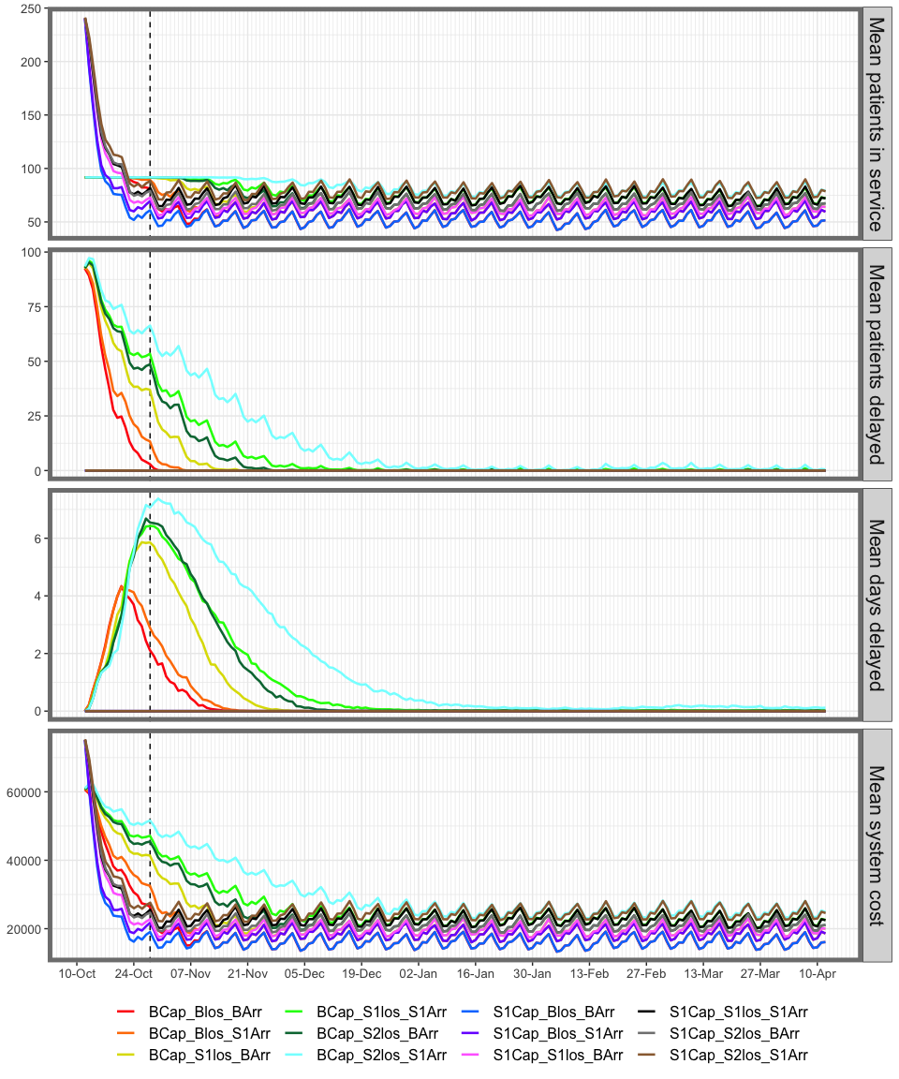
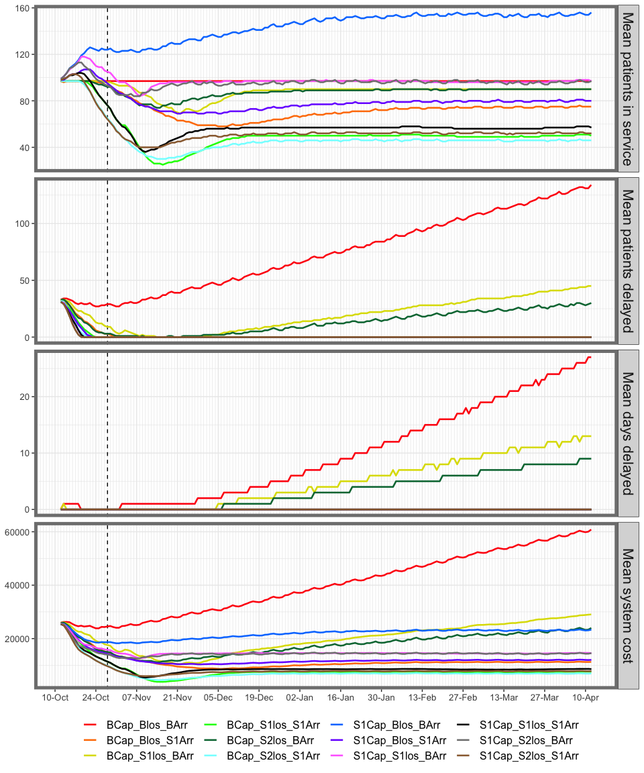
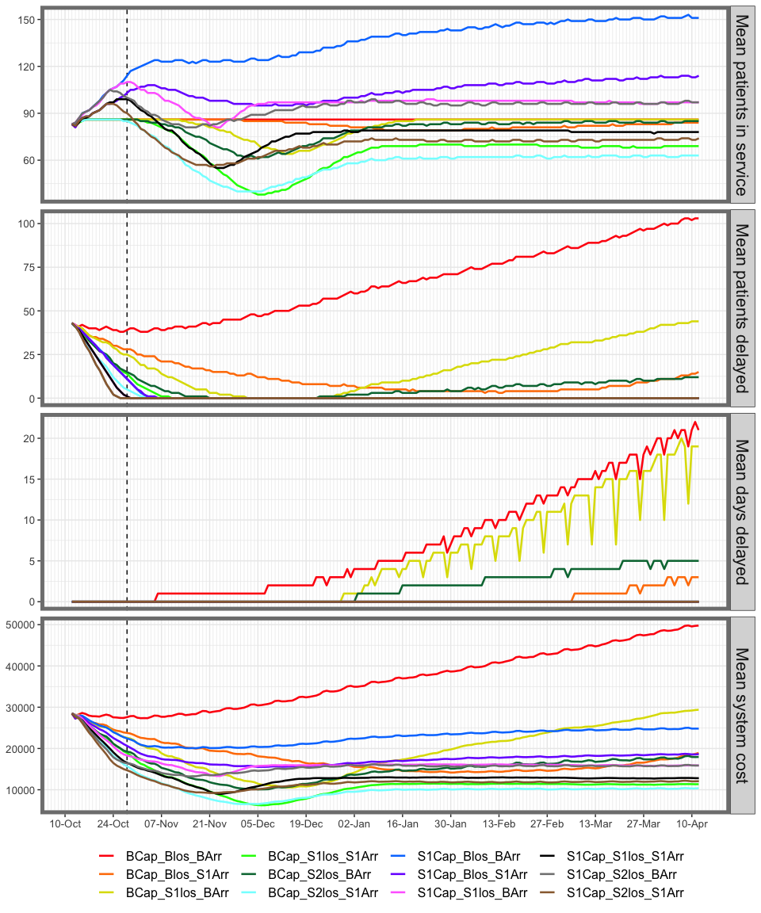
Sample Outputs – Bristol
P1
P2
P3
Red line corresponds to Baseline
Black line corresponds to Target

Slide 16
Main Insights
Increases in demand for hospital care will likely lead to increases in demand for step-down services and facilities
Not expanding capacity in intermediate care leads to:
more patients being delayed in hospitals
poorer patient outcomes and experience
greater inefficiencies for other acute care services (e.g., elective care capacity)
higher overall costs for the health and social care system
We developed an open-source simulation tool that can assess optimal capacity of intermediate care that minimizes patients who do not meet ‘criteria to reside’ in an acute hospital.

Slide 17
Next Steps
Our simulation results have been circulated to the ICB and the Intermediate Care decision makers and are under active discussion (Winter pressures, 2023/2024 capacity planning)
The tool is being handed over to NHS in-house analysts for routine use
Further dissemination and engagement with other ICBs including Somerset
We plan to extend the model scope to further downstream into social care, as insufficient capacity here causes similar issues for intermediate care

Slide 18
Thank you!
Upcoming: NHS-R Workshop The IPACS complex care pathway simulation model Tuesday 22nd November 2022

